Slide 1
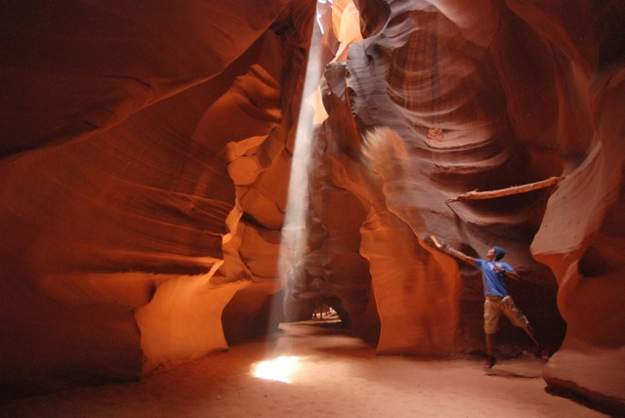
Erosion by Wind

Slide 2
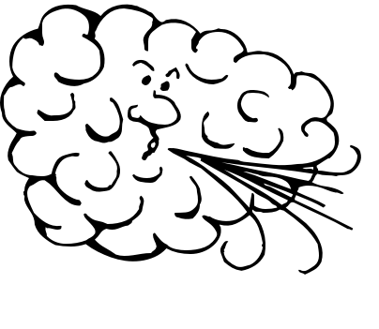
Erosion by Wind
Remember, erosion is the process by which weathered products are moved. Wind is one way weathered products are moved.

Slide 3
Where does wind erosion occur?
Places where there is little vegetation (plants, trees, grass)
Places where there is little water (moisture makes the soil heavier→ harder to move)
Ex. Beach and desert

Slide 4
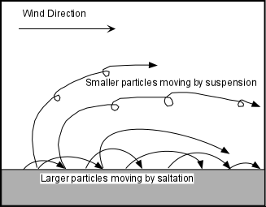
How does wind move sand?
Wind causes the sand to jump and bounce. This is called saltation.
Grains of sand only rise above the surface ~1 m even in the strongest wind.

Slide 5
Effects of Wind Erosion
Deflation: wind removes topsoil, lowers the land and leaves rock fragments that are too large to be lifted. Common in deserts.
Example: Dust Bowl
Abrasion: rocks get worn down and smoothed mostly by blowing sand.

Slide 6
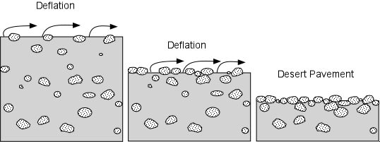
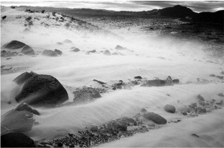
Notes:
http://www.google.com/imgres?imgurl=http://earthsci.org/education/teacher/basicgeol/windes/deflation.jpg&imgrefurl=http://earthsci.org/education/teacher/basicgeol/windes/windes.html&usg=__asBdEYm3ymDvztbhGsTYRDBJyHM=&h=201&w=538&sz=35&hl=en&start=0&zoom=1&tbnid=sVz0vQ6QkbvbyM:&tbnh=66&tbnw=177&prev=/images%3Fq%3Ddeflation%2Bin%2Bdesert%26um%3D1%26hl%3Den%26biw%3D1280%26bih%3D685%26tbs%3Disch:1&um=1&itbs=1&iact=hc&vpx=81&vpy=113&dur=547&hovh=71&hovw=191&tx=152&ty=49&ei=Ey2pTISjIYOglAeQk_ieDA&oei=Ey2pTISjIYOglAeQk_ieDA&esq=1&page=1&ndsp=24&ved=1t:429,r:0,s:0
http://www.google.com/imgres?imgurl=http://www.agu.org/pubs/sample_articles/sp/2000JE001481/2001je001481-o23.jpg&imgrefurl=http://www.agu.org/pubs/sample_articles/sp/2000JE001481/figures.shtml&usg=__QlJSJdtycR1rTwRKexKkdttZzv0=&h=207&w=312&sz=22&hl=en&start=0&zoom=1&tbnid=HoCZ0DSrDb6_RM:&tbnh=165&tbnw=227&prev=/images%3Fq%3Dwind%2Babrasion%26um%3D1%26hl%3Den%26biw%3D1280%26bih%3D685%26tbs%3Disch:1&um=1&itbs=1&iact=rc&dur=401&ei=6S2pTOGjHYG0lQeazdSxDA&oei=6S2pTOGjHYG0lQeazdSxDA&esq=1&page=1&ndsp=15&ved=1t:429,r:7,s:0&tx=95&ty=125

Slide 7
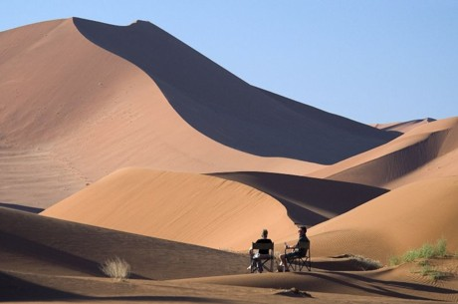
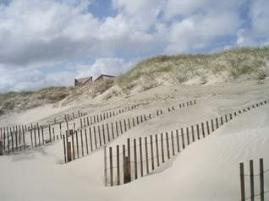
Effects of Wind Erosion
Dunes: Sand gets deposited by the wind and causes dunes to form.
Dunes: mounds of sand blown by the wind.
Common in deserts, on beaches and on the shores of large lakes.
Notes:
http://www.google.com/imgres?imgurl=http://cmsimg.newsleader.com/apps/pbcsi.dll/bilde%3FSite%3DAA%26Date%3D20100919%26Category%3DLIFESTYLE%26ArtNo%3D9190301%26Ref%3DAR%26MaxW%3D318%26Border%3D0&imgrefurl=http://www.newsleader.com/article/20100919/LIFESTYLE/9190301/Carolina-s-4x4-shores-are-hidden-treasure&usg=__E_krxmrnqBcaZOmZbrXM-z65jic=&h=238&w=318&sz=10&hl=en&start=85&zoom=1&tbnid=IK7tEa_OrnvNCM:&tbnh=167&tbnw=223&prev=/images%3Fq%3Dnorth%2Bcarolina%2Bsand%2Bdunes%26um%3D1%26hl%3Den%26biw%3D1280%26bih%3D685%26tbs%3Disch:10,3198&um=1&itbs=1&iact=hc&vpx=532&vpy=143&dur=382&hovh=168&hovw=224&tx=187&ty=59&ei=Dy-pTKSbKIH88Aaoy7CGDQ&oei=9i6pTLLJOIS0lQfo9_nODA&esq=6&page=6&ndsp=15&ved=1t:429,r:12,s:85&biw=1280&bih=685
http://www.google.com/imgres?imgurl=http://african-safari-and-travel-advisor.com/images/namibia-african-safari-dunes-at-sossusvlei-w-dana-allen-b.jpg&imgrefurl=http://www.african-safari-and-travel-advisor.com/African-holidays.html&usg=__kImBmNUXUCL8mtVflAnjuQoxyUk=&h=305&w=460&sz=27&hl=en&start=31&zoom=1&tbnid=DZDUu0zyZtnyAM:&tbnh=137&tbnw=206&prev=/images%3Fq%3Ddunes%26um%3D1%26hl%3Den%26biw%3D1280%26bih%3D685%26tbs%3Disch:10,1174&um=1&itbs=1&iact=hc&vpx=971&vpy=106&dur=423&hovh=137&hovw=206&tx=159&ty=109&ei=OS-pTK73KoK78gaPyqDVDA&oei=Wy6pTOLLHcX_lgetufTHDA&esq=2&page=3&ndsp=15&ved=1t:429,r:4,s:31&biw=1280&bih=685

Slide 8
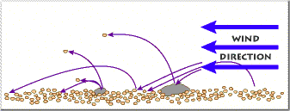
What is this?

Slide 9
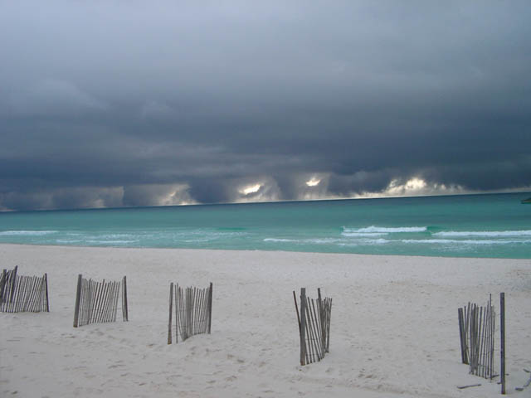
What is the purpose of the fences?

Slide 10
True or False
Saltation is the jumping and bouncing movement of sand.
Deflation is when rocks get worn down and smoothed mostly by blowing sand.
Sand that is deposited by wind forms dunes.
Wind erosion generally occurs where there is a lot of vegetation and a lot of water.

