Slide 1
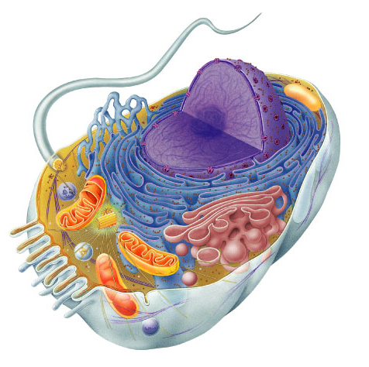
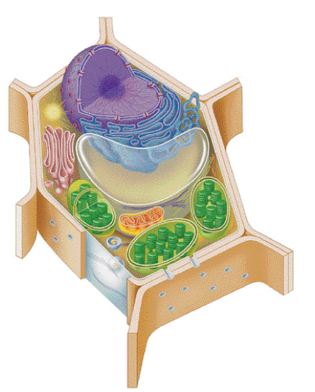
Cells & Cell Organelles
Doing Life’s Work
2009-2010

Slide 2
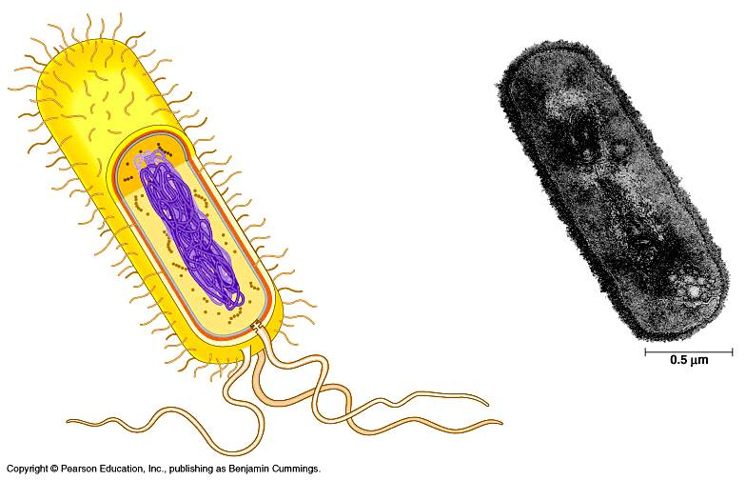
Types of cells
bacteria cells
Prokaryote
- no organelles
Eukaryotes
- organelles
animal cells
plant cells

Slide 3
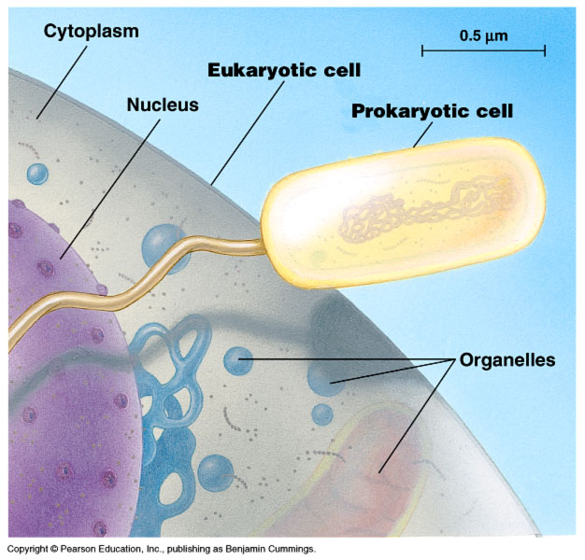
Cell size comparison
Animal cell
most bacteria
1-10 microns
eukaryotic cells
10-100 microns
Bacterial cell
micron = micrometer = 1/1,000,000 meter
diameter of human hair = ~20 microns

Slide 4
Why study cells?
Cells → Tissues → Organs → Bodies
bodies are made up of cells
cells do all the work of life!

Slide 5
The Work of Life
What jobs do cells have to do for an organism to live…
“breathe”
gas exchange: O₂ in vs. CO₂ out
eat
take in & digest food
make energy
ATP
build molecules
proteins, carbohydrates, fats, nucleic acids
remove wastes
control internal conditions
homeostasis
respond to external environment
build more cells
growth, repair, reproduction & development
ATP

Slide 6
The Jobs of Cells
Cells have 3 main jobs
make energy
need energy for all activities
need to clean up waste produced while making energy
make proteins
proteins do all the work in a cell, so we need lots of them
make more cells
for growth
to replace damaged or diseased cells
Our organelles do all these jobs!

Slide 7
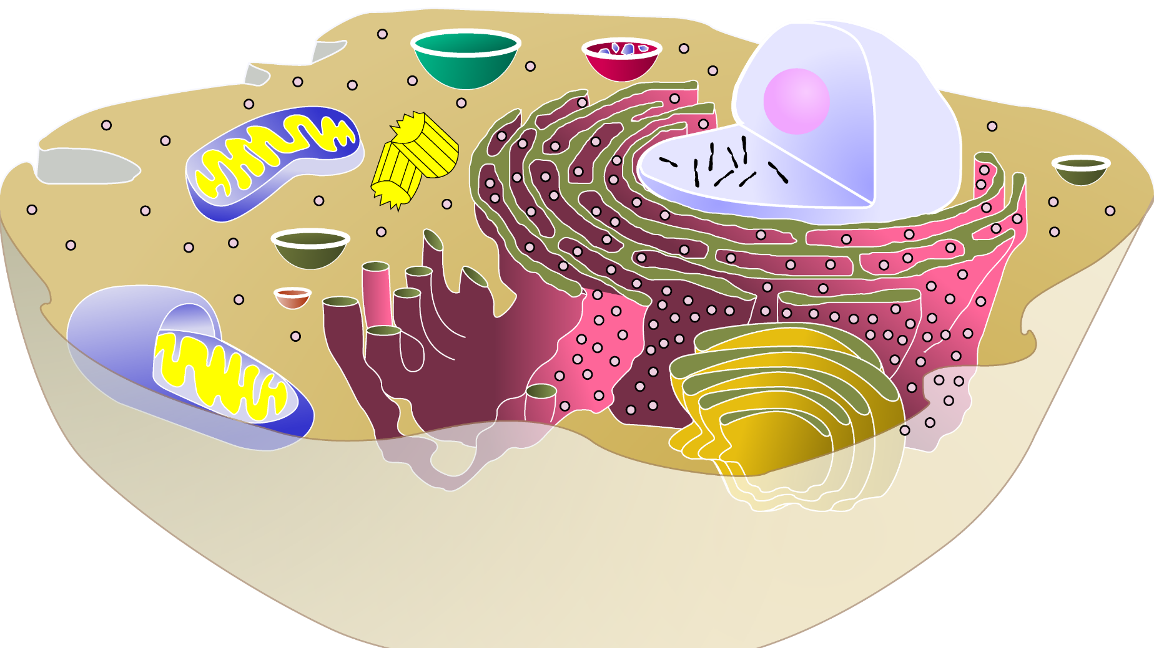
Organelles
Organelles do the work of cells
each structure has a job to do
keeps the cell alive; keeps you alive
They’re like mini-organs!
Model Animal Cell

Slide 8
1. Cells need power!
Making energy
to fuel daily life & growth, the cell must…
take in food & digest it
take in oxygen (O₂)
make ATP
remove waste
organelles that do this work…
cell membrane
vacuoles
mitochondria
ATP

Slide 9
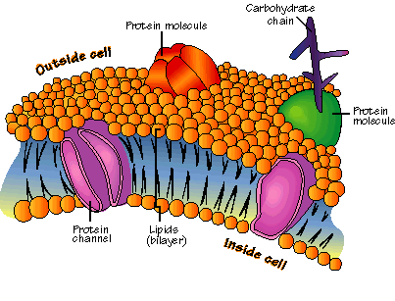
Cell membrane
phosphate “head”
Function
separates cell from outside
controls what enters or leaves cell
O₂, CO₂, food, H₂O, nutrients, waste
recognizes signals from other cells
allows communication between cells
Structure
double layer of fat
phospholipid bilayer
proteins
lipid “tail”

Slide 10
cytoplasm
▪jelly-like material holding organelles in place
cell membrane
▪cell boundary
▪controls movement of materials in & out
▪recognizes signals

Slide 11
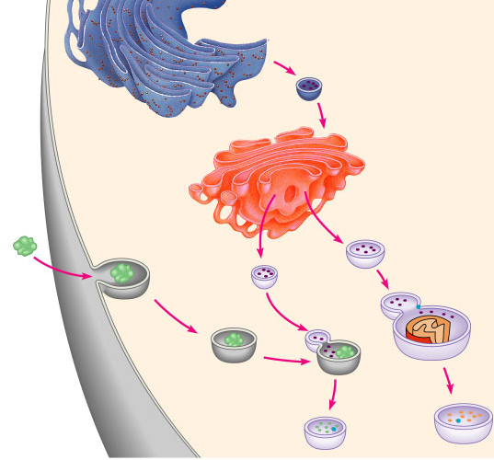
Vacuoles
Function
storage
vacuole filled w/ digestive enzymes

Slide 12
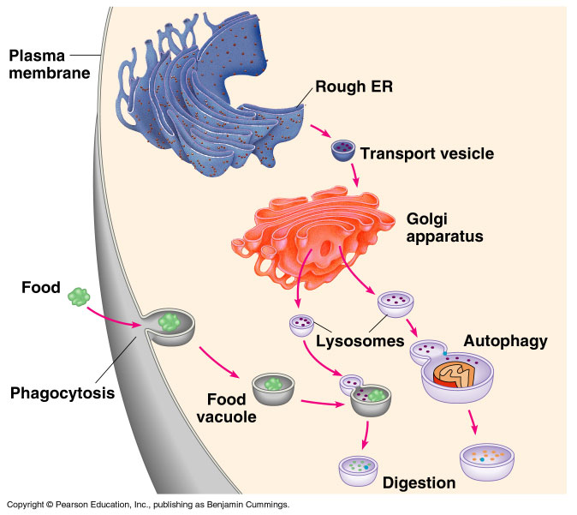
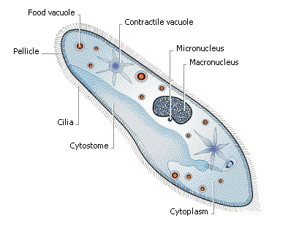
Food & water storage
food vacuole
plant cells
central vacuole
animal cells
contractile vacuole

Slide 13
cytoplasm
▪jelly-like material holding organelles in place
vacuole
▪storage
cell membrane
▪cell boundary
▪controls movement of materials in & out
▪recognizes signals

Slide 14
cytoplasm
▪jelly-like material holding organelles in place
vacuole & vesicles
▪transport inside cells
▪storage
cell membrane
▪cell boundary
▪controls movement of materials in & out
▪recognizes signals

Slide 15
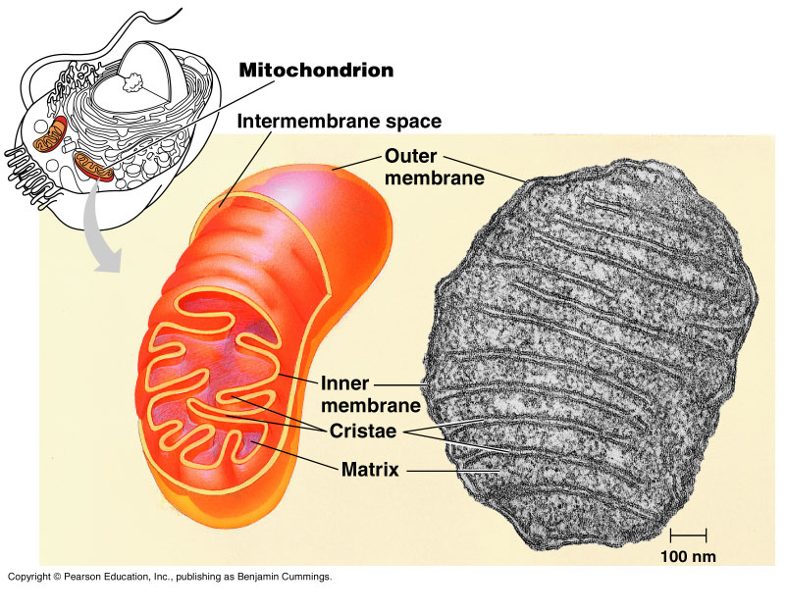
Mitochondria
Function
make ATP energy from cellular respiration
sugar + O₂ → ATP
fuels the work of life
Structure
double membrane
ATP
in both animal & plant cells

Slide 16
cytoplasm
▪jelly-like material holding organelles in place
vacuole & vesicles
▪transport inside cells
▪storage
mitochondria
▪make ATP energy from sugar + O₂
cell membrane
▪cell boundary
▪controls movement of materials in & out
▪recognizes signals

Slide 17
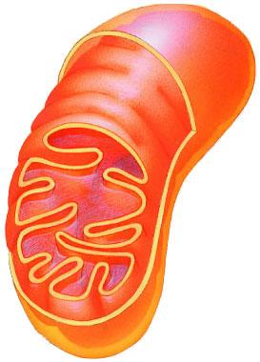
Plants make energy two ways!
ATP
Mitochondria
make energy from sugar + O₂
cellular respiration
sugar + O₂ → ATP
Chloroplasts
make energy + sugar from sunlight
photosynthesis
sunlight + CO₂ → ATP & sugar
ATP = active energy
sugar = stored energy
build leaves & roots & fruit out of the sugars
sugar
ATP

Slide 18
Mitochondria are in both cells!!
animal cells
plant cells
mitochondria
chloroplast

Slide 19
cytoplasm
▪jelly-like material
around organelles
central vacuole
▪storage: food, water or waste
mitochondria
▪make ATP in cellular respiration
cell wall
▪support
cell membrane
▪cell boundary
▪controls movement of materials in & out
▪recognizes signals
chloroplast
▪make ATP & sugars in photosynthesis

Slide 20
2. Cells need workers = proteins!
Making proteins
to run daily life & growth, the cell must…
read genes (DNA)
build proteins
structural proteins (muscle fibers, hair, skin, claws)
enzymes (speed up chemical reactions)
signals (hormones) & receptors
organelles that do this work…
nucleus
ribosomes

Slide 21
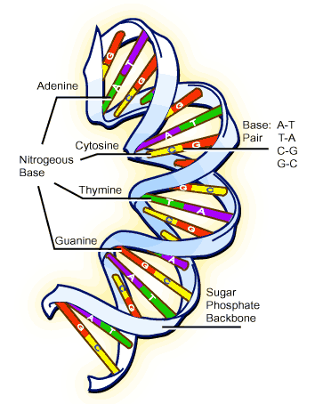
Proteins do all the work!
one of the major job of cells is to make proteins,
because…
proteins do all the work!
structural
enzymes
signals
receptors
DNA
proteins
cells

Slide 22
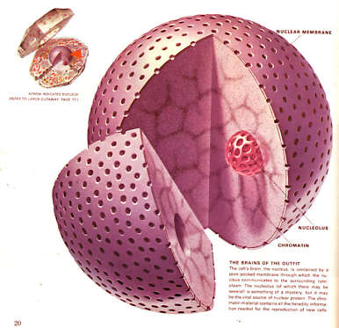
Nucleus
Function
control center of cell
protects DNA
instructions for building proteins
Structure
nuclear membrane
chromosomes
DNA

Slide 23
cytoplasm
▪jelly-like material holding organelles in place
vacuole
▪storage
nucleus
▪protects DNA
▪controls cell
chromosomes
▪DNA
mitochondria
▪make ATP energy from sugar + O₂
cell membrane
▪cell boundary
▪controls movement of materials in & out
▪recognizes signals

Slide 24
Ribosomes
Function
protein factories
read instructions to build proteins from DNA
Structure
some free in cytoplasm
some attached to ER
Ribosomes on ER

Slide 25
cytoplasm
▪jelly-like material holding organelles in place
vacuole
▪storage
nucleus
▪protects DNA
▪controls cell
ribosomes
▪build proteins
mitochondria
▪make ATP energy from sugar + O₂
cell membrane
▪cell boundary
▪controls movement of materials in & out
▪recognizes signals

Slide 26
cytoplasm
▪jelly-like material holding organelles in place
vacuole
▪storage
nucleus
▪protects DNA
▪controls cell
ribosomes
▪builds proteins
mitochondria
▪make ATP energy from sugar + O₂
cell membrane
▪cell boundary
▪controls movement of materials in & out
▪recognizes signals

Slide 27
cytoplasm
▪jelly-like material holding organelles in place
vacuole
▪storage
nucleus
▪protects DNA
▪controls cell
ribosomes
▪builds proteins
mitochondria
▪make ATP energy from sugar + O₂
cell membrane
▪cell boundary
▪controls movement of materials in & out
▪recognizes signals

Slide 28
nucleus
▪control cell
▪protects DNA
ribosomes
▪make proteins
cytoplasm
▪jelly-like material
around organelles
central vacuole
▪storage: food, water or waste
mitochondria
▪make ATP in cellular respiration
cell wall
▪support
cell membrane
▪cell boundary
▪controls movement of materials in & out
▪recognizes signals
chloroplast
▪make ATP & sugars in photosynthesis

