Slide 1
Latitude and Longitude

Slide 2
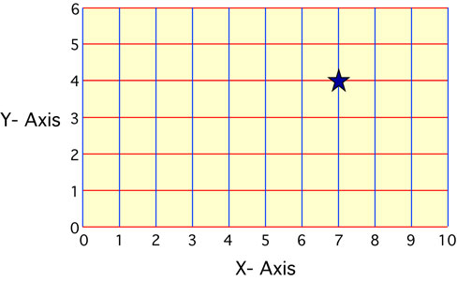
Coordinate system- a system of intersecting lines used to determine locations on the Earth’s surface

Slide 3
Latitude
Latitude: Measures distance North and South of the Equator
Parallels: imaginary lines that run E to W
Latitude of the Equator = 0º
Imaginary line; divides Earth into N and S hemispheres
Latitude of the North and South Poles = 90º N or S

Slide 4
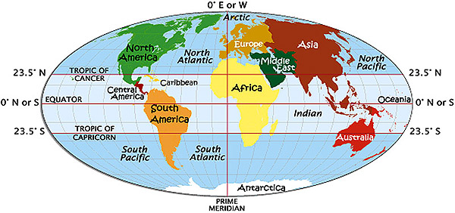
Tropics of Cancer and Capricorn
Tropic of Cancer: 23.5°N
Tropic of Capricorn: 23.5°S
Furthest north or south you can be for the sun to be directly overhead at sometime in the year

Slide 6
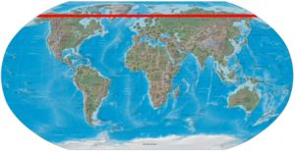
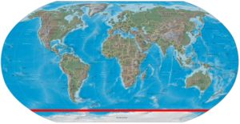
Arctic and Antarctic Circles
60° N and S of equator

Slide 7
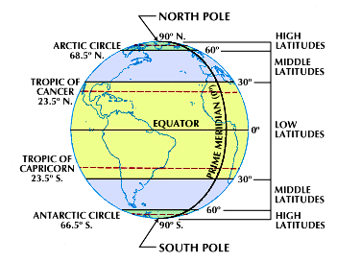

Slide 8
Longitude
Longitude: Measures distance in degrees east and west of the Prime Meridian.
Meridians: lines of longitude; imaginary lines that run N to S, but measure distances E and W of the Prime Meridian
Not parallel; intersect at poles
Prime Meridian --> 0º (Greenwich, England) reference line

Slide 9
