Slide 1
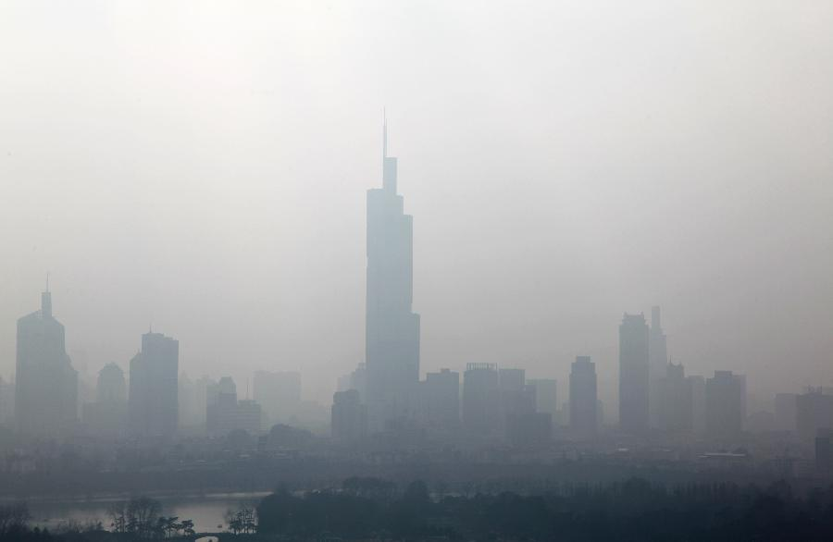
Air Quality Impact

Slide 2
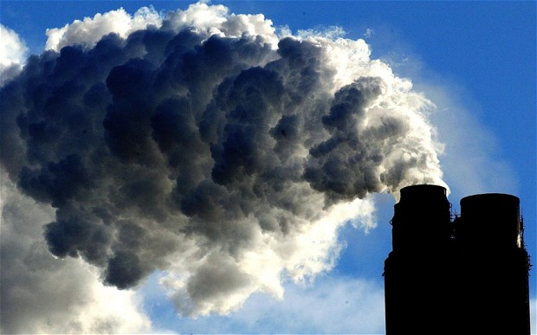
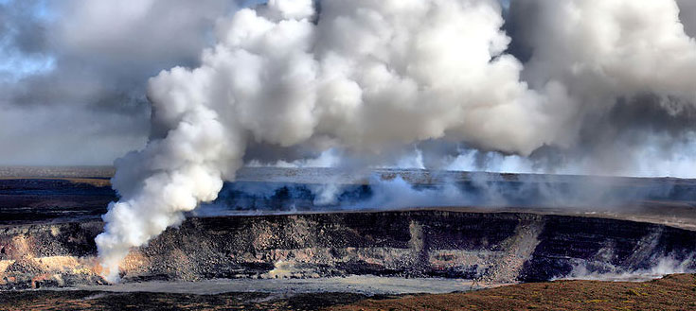
Human Effects
Air Pollution – Substance created by with an adverse affect on the atmosphere.
Can be man-made or natural
Example of each?

Slide 3
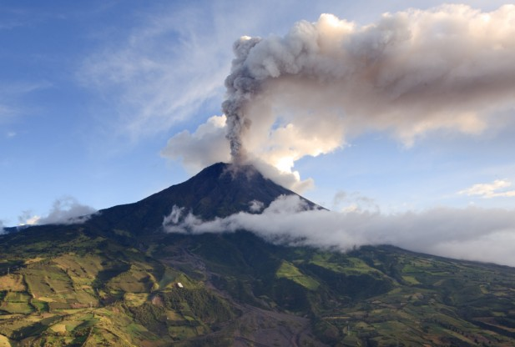
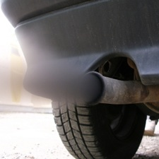
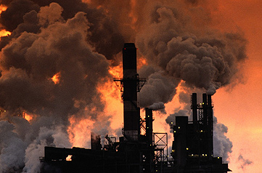
Main Types
Sulfur Oxides – Created by volcanoes and factories. Sulfur can bond with oxygen in air to create acid rain.
Nitrogen Oxides – Created by thunderstorms and combustion engines. Toxic
Carbon Oxides – Created by volcanoes and combustion engines. Can be toxic

Slide 4
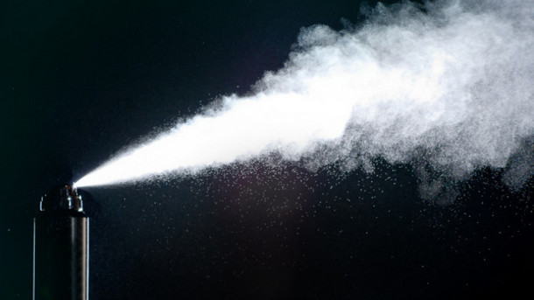
Main Types
Particulates – airborne solids. Can cause cancer
ChloroFluoroCarbon’s- (CFC’s) a pollutant found in aerosols, breaks down ozone
Loss of ozone can lead to harmful UV radiation

Slide 5
Sources
Stationary Sources – Coal power plants, Industrial Factories
Mobile Sources – cars, planes, ships
Fumes – aerosols, paint, hair spray
Waste Deposition- landfills create gases as waste breaks down

Slide 6
Solutions
Scrubbers- remove gases or particles from a point source location.
Regulation- Country uses standards to prevent too much pollution to come from one location
Ex. Clean Air Act of 1963

Slide 7
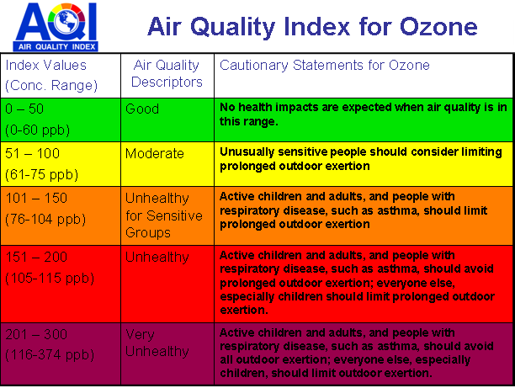
Air Quality Index- Indicates to the public the health risk at a location and time.

Slide 8
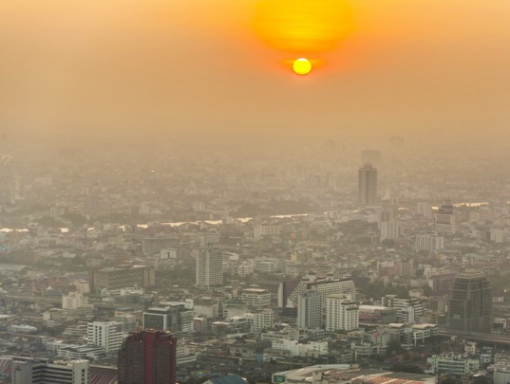
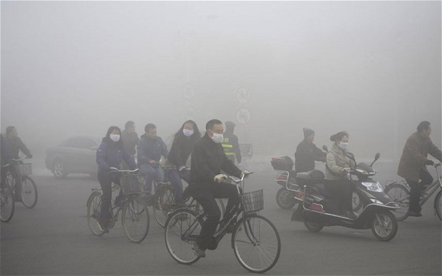

Slide 9
