Slide 1
Heating the Atmosphere

Slide 2
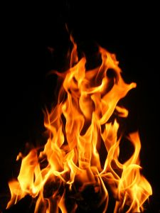
Heat
When air transfers heat energy to a cooler object, the air temperature decreases
What are some ways that you can heat up an object?

Slide 3
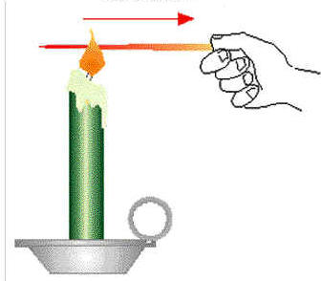
Conduction
The transfer of heat through matter by direct contact.
Heat flows from the warm object to the colder one
Conductors vs. Non-conductors:
Some materials are very good at transferring heat, like metals (conductors), while others are not, like air (non-conductor)

Slide 4
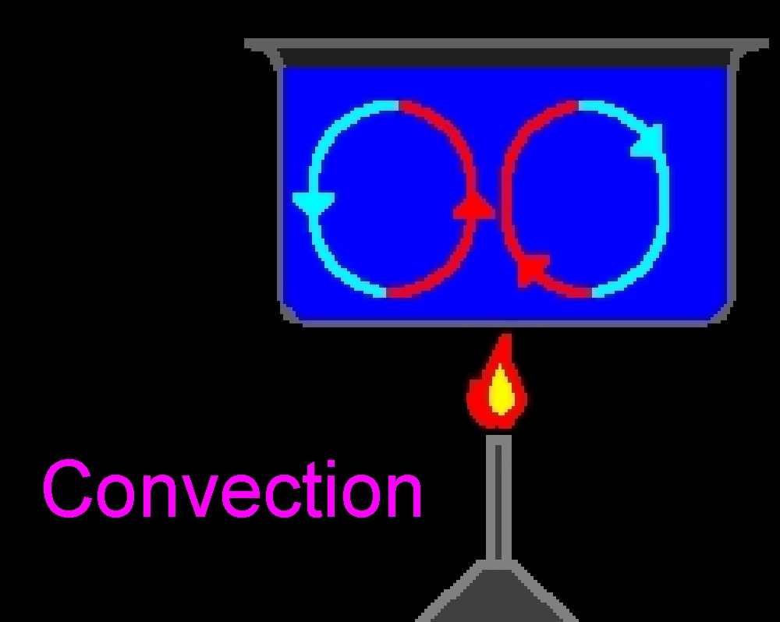
Convection
The transfer of heat by the circulation of currents within a substance.
When you boil a pot of water the warm water at the bottom of the pot expands and rises.
This is called a convection current.

Slide 5
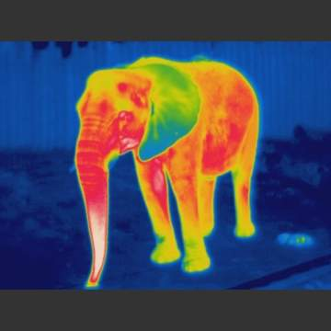
Radiation
The transfer of heat through space by electromagnetic waves
Most heating of the atmosphere comes from radiation

Slide 6
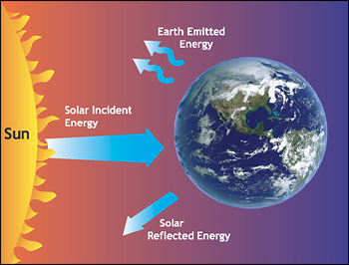
Solar Radiation
When radiation strikes an object 3 results
Some energy is absorbed by the object
Substances such as water/air are transparent to radiation and transmit it (energy passes through it)
Some radiation may bounce off the object without being absorbed or transmitted.

Slide 7
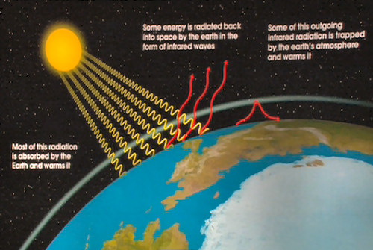
Greenhouse Effect
The Sun radiates energy to the Earth and naturally warms the lower atmosphere and surface
Some heat re-radiates and escapes into space.
Some heat gets trapped by the atmosphere and warms the air.
Greenhouse gases in the atmosphere absorb some of the Earth’s re-radiated heat, but are transparent to incoming solar radiation

Slide 8
Greenhouse Gases
Water Vapor (H2O), Carbon Dioxide (CO2), and Methane (CH4)
Carbon dioxide is most often the focus of public discussion
Humans burning fossil fuels releases carbon dioxide into the atmosphere increasing the greenhouse effect leading to global warming.
Industrial factories could decrease the carbon dioxide levels in the atmosphere by transitioning from burning fossil fuels to using alternative energies

Slide 9
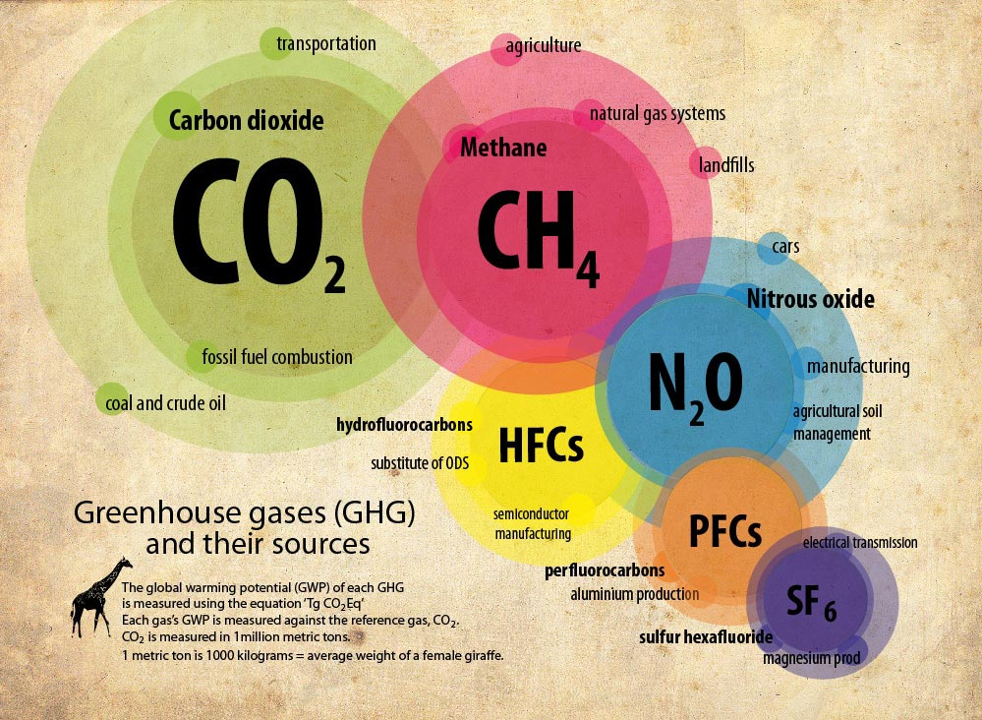

Slide 10
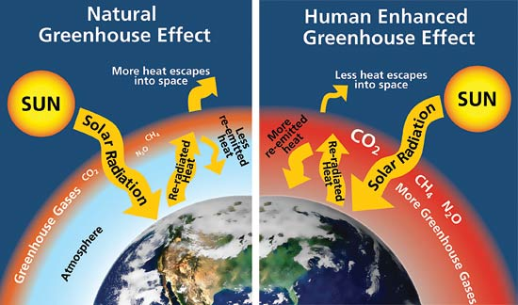
A human enhanced greenhouse effect leads to global warming

Slide 11
Why do some places heat differently?
Global temperatures vary due to several things

Slide 12
Land vs. Water
Land heats more rapidly than water
Land reaches higher temperatures than water
How might this affect a coastal city vs. a land locked city?
Temperatures of a body of water influence the temperatures of the air above it

Slide 13
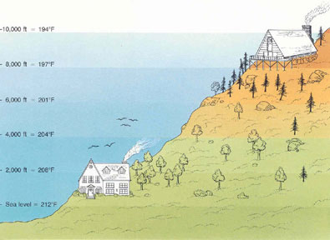
Altitude
Places at higher altitudes have cooler temperatures than places at lower altitudes
Ex. Boone vs. Wilmington

Slide 14
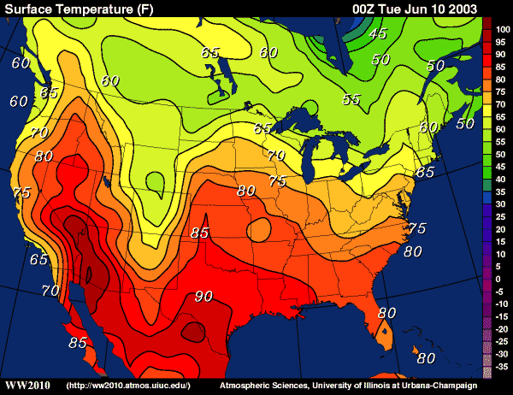
World Temperature
Isotherms- lines that connect points of equal temperature
By studying isotherm maps you can detect patterns and see the effects of phenomena.

