Slide 1
Natural Resources

Slide 2
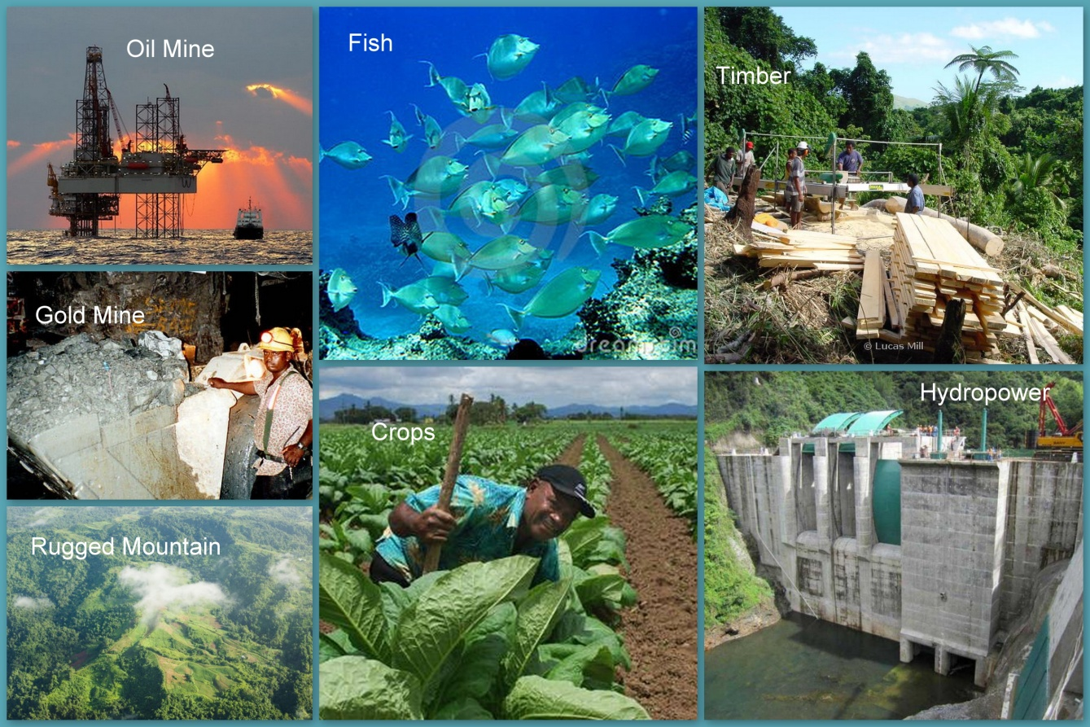
Natural Resources
Materials or substances such as minerals, forests, water, and fertile land that occur in nature and can be used for economic gain
Two types: renewable and nonrenewable

Slide 3
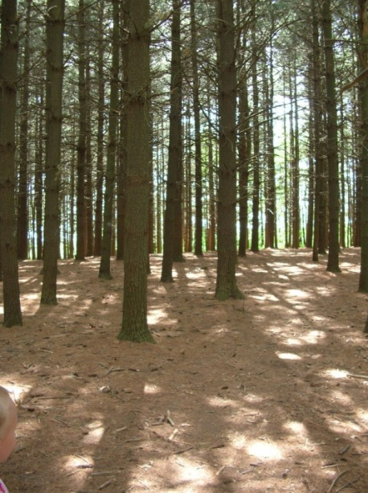
Renewable Resources
Resource that can be replaced at a rate close to its rate of use or in an unlimited supply.
Examples: oxygen, nitrogen (air), trees (lumber), water, solar energy

Slide 4
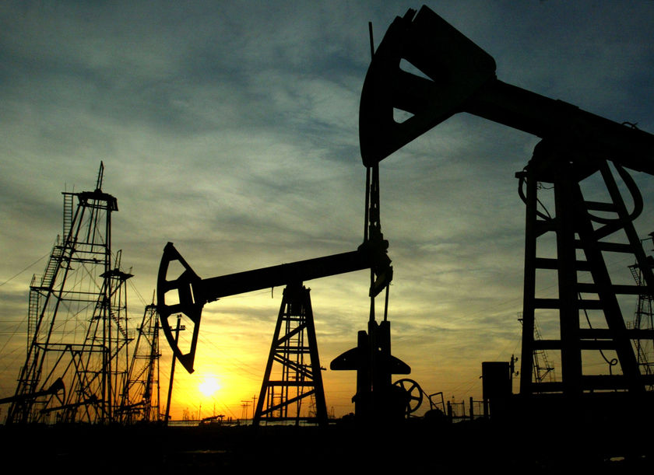
Nonrenewable Resources
Resources of a fixed amount, or a resource that is used up faster than it can be replaced
Examples:
Metals (Au, Fe, Cu, etc.),
Nonmetals (gravel, limestone, etc.)
Energy sources (coal, oil, petroleum, etc.)

Slide 5
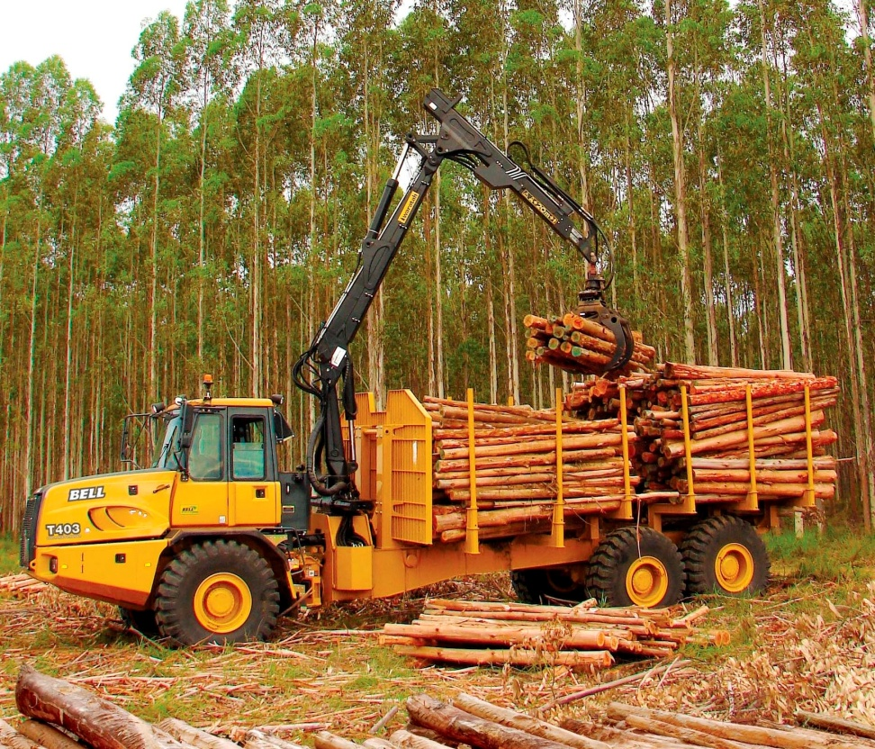
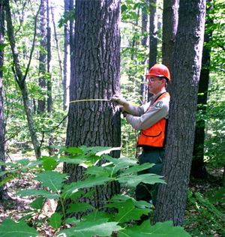
NC Forestry Resources
Christmas Trees
Variety of trees for timber

Slide 6
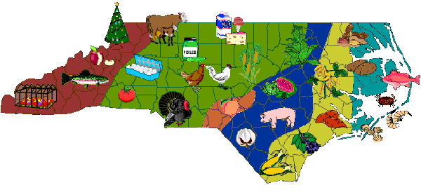
NC Agriculture Resources
Field Crops
Tobacco
Cotton
Soybean
Livestock
Hogs
Cows
Turkeys

Slide 7
Land Uses

Slide 8
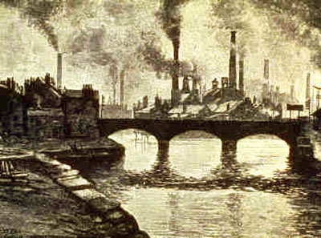
Industrialization
The large-scale introduction of manufacturing, advanced technical enterprises, and other productive economic activity into an area, society, country, etc.

Slide 9
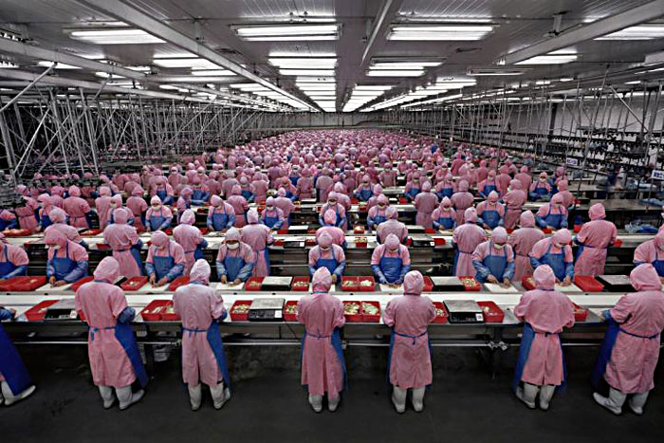
Consequences
Positive
- Unskilled Job Growth
- Economic Opportunity
Negative
- Lower Paying Jobs/Poor Working Conditions
- Urbanization
- Lack of environmental awareness

Slide 10
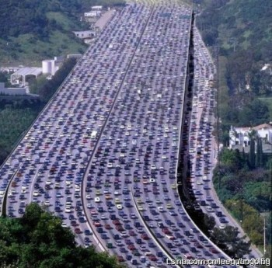
Urbanization
The process by which towns and cities are formed and become larger as more and more people begin living and working in central areas

Slide 11
Consequences
Positive
Lower Birth Rates
Lower Rural Populations/Better Farming Practices
Negative
Heat Islands
Destruction of natural habitat/Waste
High energy consumption/temperatures
Higher percentage of health problems

Slide 12
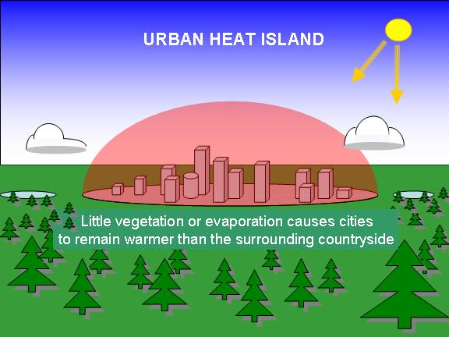
Heat Islands
Heat Island - a city that has increased temperatures due to having asphalt, buildings, and other dark structures that absorb and hold heat longer than natural environments

Slide 13
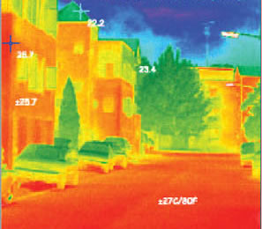
Consequences
Negative
Increased temperatures: 1-10 deg F
Increased Energy Demand
Strain on Wildlife
Urban Heat Isle

Slide 14
Mitigation
In order to combat heat islands efforts through mitigation have been made
Greening of City
Change in construction material
Reduction of Heat Sources

Slide 16
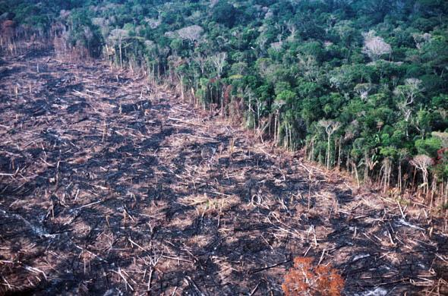
Deforestation
Natural forests are cleared through logging and/or burning
Amazon is the largest rainforest in the world
Since 1970 20% of the rainforest has been cut down

Slide 17
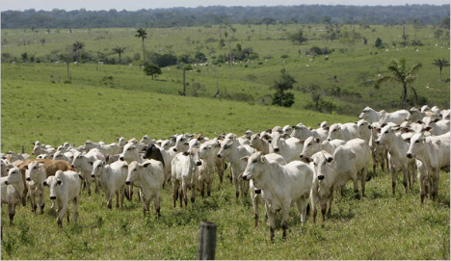
Consequences
Positive
Logging
Cattle Raising
Agriculture/Food
Negative
Decrease of biodiversity
Loss of plant life
Increased Global Warming

